Slide 1
Normal modes in three dimensions
2nd November 2020

Slide 2
Waves equation in 3 dimensions
Recall, the wave equation in 3 dimensions can be written as
The solution of the equation can be found from the method of separation of variables.
The general solution, i.e., the wave function, is found to be

Slide 3
Standing waves in rectangular enclosure
Consider a rectangular enclosure as illustrated in the figure, l₁, l₂ and l₃ are lengths of the sides of the rectangular enclosure.
The wave function describing the standing waves inside the enclosure have to satisfy the following boundary conditions.
(0,0,l₃)
z
y
(0,l₂,0)
l₂
l₃
x
(0,0,0)
(l₁,0,0)
l₁

Slide 4
A particular wave function within the rectangular enclosure
By applying the first boundary condition, φ = 0 @ x = y = z = 0 at all times, the wave function becomes
Likewise, the application of the second boundary condition, φ = 0 @ x = l₁, y = l₂ and z = l₃ at all times, leads to the particular wave function
where n₁, n₂ and n₃ are integers.

Slide 5
Normal mode frequency of standing wave in a rectangular enclosure
Substituting the particular wave function into the 3 D wave equation, we then obtain
This leads to
Or
Finally, the normal mode frequency ν;
The allowed standing wave must have wave vectors that satisfy this condition.

Slide 6
Normal mode frequency
Recall the normal mode frequency from the previous slide,
The labels; i.e., n₁n₂n₃, need not all have the same value, but can be chosen quite independently of each other. Note that, setting any one of them equal to zero causes the wave function φ to vanish.
Likewise, the wave function can be expressed with the label n₁n₂n₃ as follows

Slide 7
Degenerate standing waves
Recall the relationship of the wave vectors k, k₁, k₂ and k₃,
This implies that standing waves with different composite wave vectors can have the same wave vector k, normal mode frequency and subsequently energy. Those standing wave are called “degenerate waves functions”.
For example, if l₂ = 2l₁ for any value of n₃, φ_{22n3} and φ_{14n3} are degenerate wave functions.

Slide 8
No. of normal mode frequency in a rectangular enclosure in k space
No. of normal mode frequency, representing the no. of standing waves in the rectangular closure, can be determined from either wave vector space k or frequency space ν.
If we start the analysis with the wave vector relation,
The composite components of the wave vector k
can form three perpendicular axes.
Also, it is noted that the maximum magnitude of the wave vector k
has to be within a sphere of radius k.
k₃
k
k₂
k₁
Wave vector space k
Notes:
K space คือ wave vector space

Slide 9
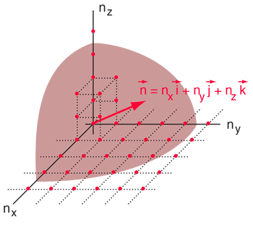
The lowest normal mode
each apparent point corresponds to a possible normal mode.
Consider the lowest normal mode having labels of n₁n₂n₃ = 111, the magnitude of the wave vector k becomes
The end point of the lowest normal mode wave vector is at the corner of a rectangular cell having lengths π/l₁, π/l₂, π/l₃ along k₁, k₂ and k₃, respectively, with a volume π³/l₁l₂l₃ .
There are as many cells as points since each cell has eight points at its corners and each point serves as a corner to eight cells.
Therefore, this suggests that the number of modes can be determined from the ratio of the spherical volume to the volume of a cell.
However, only one octant of the sphere gives a unique set of normal mode.
k₃
π/l₃
k₂
π/l₁
π/l₂
k₁
Wave vector space k
http://hyperphysics.phy-astr.gsu.edu/hbase/quantum/rayj.html
Notes:
Number of modes can be found from the ratio of the spherical volume (its radius corresponding to the highest normal mode) and the volume of a cell.

Slide 10
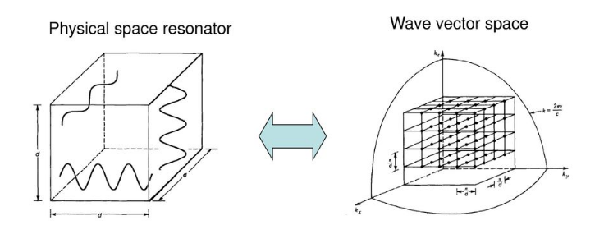
The number of normal modes
The number of normal modes can be calculated from
https://slideplayer.com/slide/13669157/

Slide 11
No. of normal mode frequency in a rectangular enclosure in ν space
The wave vector space can be transformed into the frequency ν space as follows
Likewise, the frequency space is composed of composite
frequency components ν₁, ν₂ and ν₃ as shown in the figure.
The maximum normal mode frequency lies within the sphere
of radius ν.
ν₃
ν
ν ₂
ν ₁
frequency space ν

Slide 12
The lowest normal mode frequency
This lattice cell correspond to the lowest normal mode frequency
ν₁₁₁.

Slide 13
How many normal modes can exist in the frequency range ν to ν + dν?
The total normal mode corresponds to the number of possible points (n₁, n₂, n₃) lying in the positive octant between two concentric sphere of radii ν and ν + dν.
The total number of possible points or cell will be
Note that the mode density is given by in the frequency range ν to ν + dν
per unit volume of enclosure.
This came from the volume of the fundamental mode, c³/8l₁l₂l₃.
Notes:
Note that this result, per unit volume of the enclosure, is independent of any particular system.

Slide 14
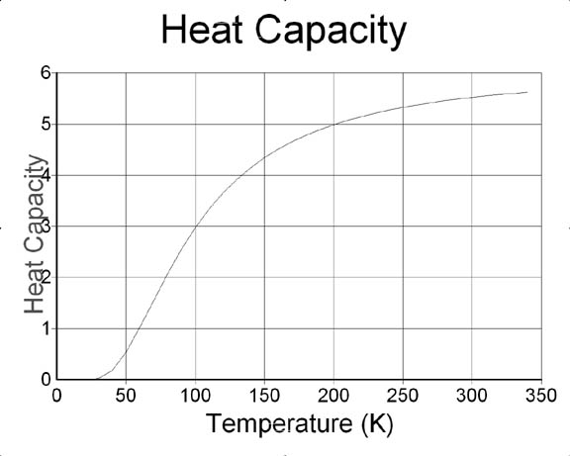
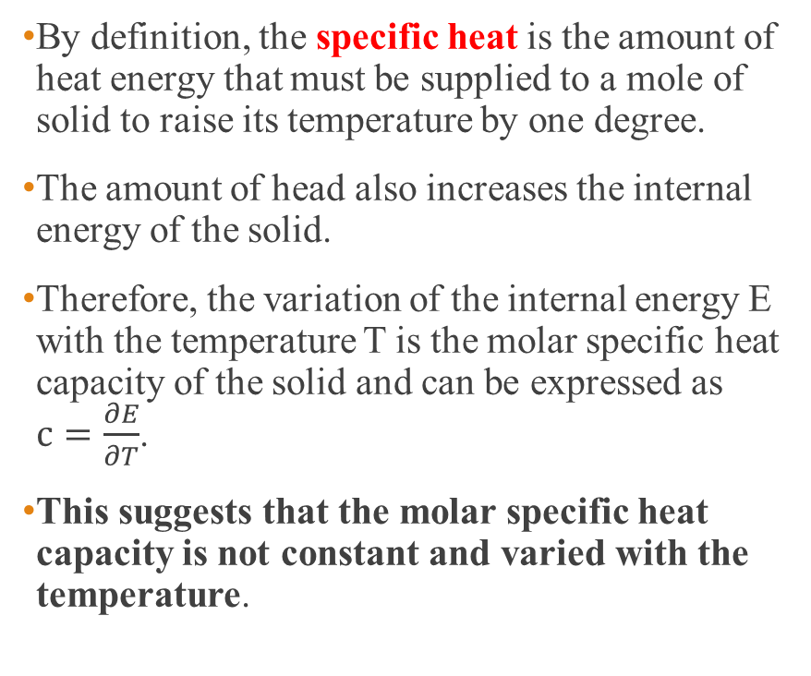
Review of the specific heat of a solid
By definition, the specific heat is the amount of heat energy that must be supplied to a mole of solid to raise its temperature by one degree.
The amount of head also increases the internal energy of the solid.
Therefore, the variation of the internal energy E with the temperature T is the molar specific heat capacity of the solid and can be expressed as $c=\frac{∂E}{∂T}$.
This suggests that the molar specific heat capacity is not constant and varied with the temperature.
http://www.applet-magic.com/heatcap.htm
Notes:
If the substance is a gas then it is important to specify whether the gas is being held at constant volume or constant pressure. For solids the difference is negligible.

Slide 15
Application of mode density : Debye theory of specific heat of a solid
Debye considered the thermal vibrations of atoms in a solid lattice correspond to the internal energy.
To determine the energy, first of all the possible mode density in the frequency interval ν to ν + dν has to be determined.
In Debye’s model, each atom was allowed two transverse vibrations (perpendicular planes of polarization) and one longitudinal vibration.
This gives the number of possible modes to be
C_{T} and C_{L} are the transverse and longitudinal velocities.
Notes:
Einstein’s model considered that each oscillator vibrates at the same frequency and no coupling between each other whatsoever.
The possible mode density here is the no of mode per unit volume!

Slide 16

Debye’s approximation
Once the mode density in the frequency range ν to ν + dν and an average energy (from Planck’s law) are known. The total energy for a solid volume V_{A} is then
Where the average energy per oscillator is given by
$\overline{ε}=\frac{hν}{e^{{hν}/{kT}}−1}$
Notes:
After the no. of modes is known

Slide 17
Debye’s approximation (cont.)
The total energy per one mole of atoms of the solid over all permitted frequencies is then
Where ν_{m} is the maximum frequency of the oscillations.
The total number of oscillation modes for one mole of the solid of volume V_{A} can be written in terms of the maximum frequency of the oscillations as follows:
In 1 mole, there are N atoms (= Avogrado’s number)
Each atom has 3 allowed oscillation modes.
Notes:
Note that no of atoms in one mole = Avogadro number N and each atom has 3 allowed oscillation modes.

Slide 18
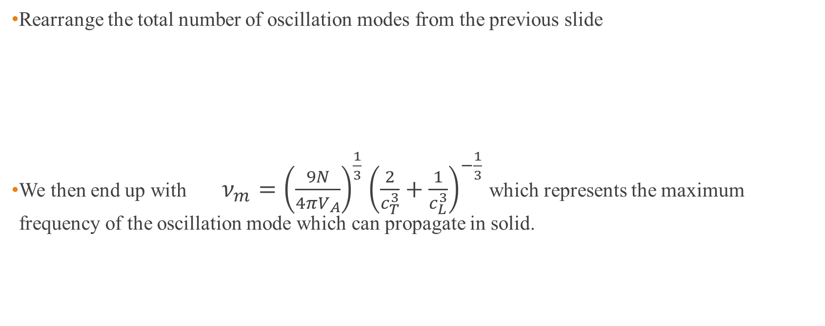
Debye’s approximation (cont.)
Rearrange the total number of oscillation modes from the previous slide
We then end up with $ν_{m}={\left(\frac{9N}{4πV_{A}}\right)}^{\frac{1}{3}}$ ${\left(\frac{2}{c_{T}^{3}}+\frac{1}{c_{L}^{3}}\right)}^{−\frac{1}{3}}$ which represents the maximum frequency of the oscillation mode which can propagate in solid.

Slide 19
Debye’s approximation (cont.)
The last equation in the previous slide gives a new form of E_{A} as
The molar specific heat of the substance at constant volume can be determine once the variation of E_{A} with temperature has been found.
In general, the specific heat is calculated from
The specific heat of aluminum calculated by this model is compared with experiment results shown in the next slide.

Slide 21
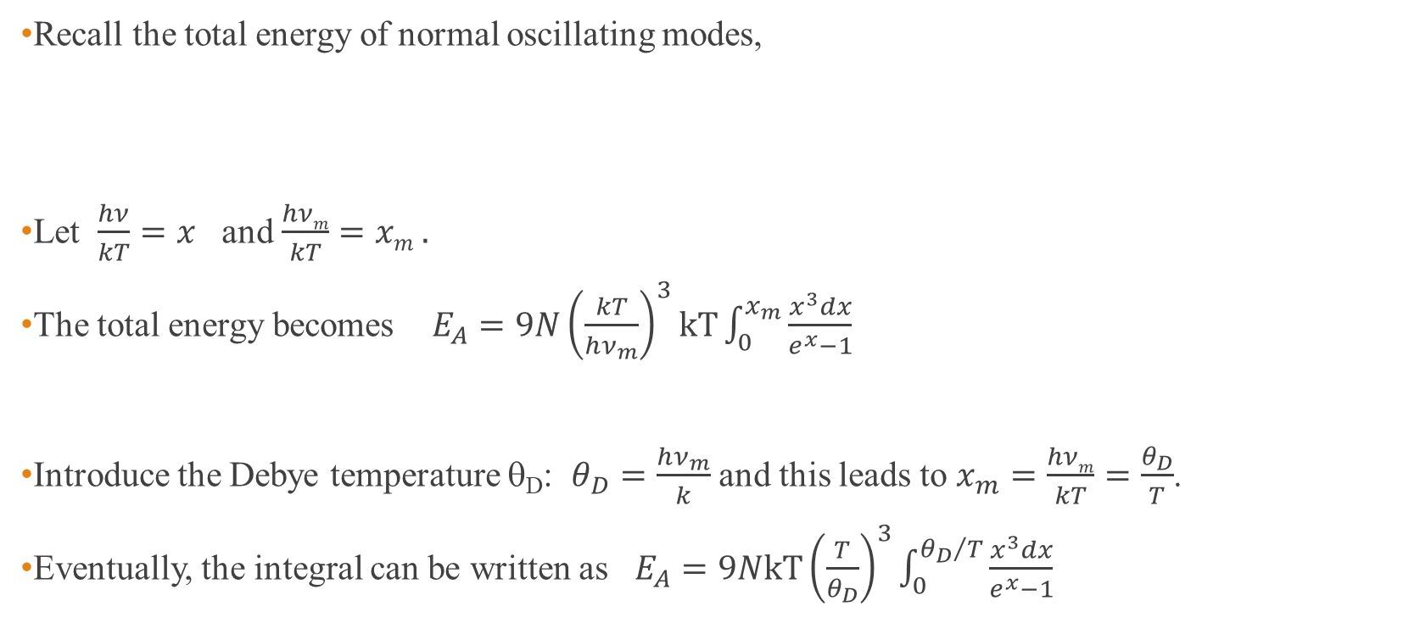
Calculation of specific heat
Recall the total energy of normal oscillating modes,
Let $\frac{hν}{kT}=x$ and $\frac{hνm}{kT}=xm .$
The total energy becomes $E_{A}=9N{\left(\frac{kT}{hν_{m}}\right)}^{3}kT\int_{0}^{x_{m}}{\frac{x^{3}dx}{e^{x}−1}}$
Introduce the Debye temperature θ_{D}: $θ_{D}=\frac{hν_{m}}{k}$ and this leads to $x_{m}=\frac{hνm}{kT}=\frac{θ_{D}}{T}$.
Eventually, the integral can be written as $E_{A}=9NkT{\left(\frac{T}{θ_{D}}\right)}^{3}\int_{0}^{{θ_{D}}/T}{\frac{x^{3}dx}{e^{x}−1}}$

Slide 22
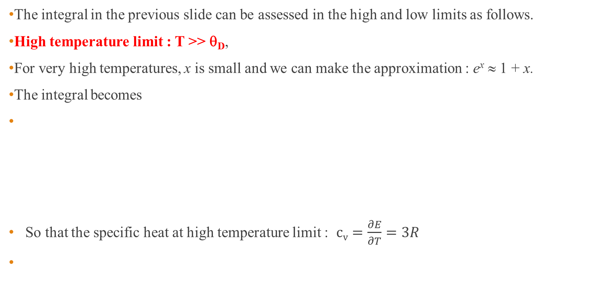
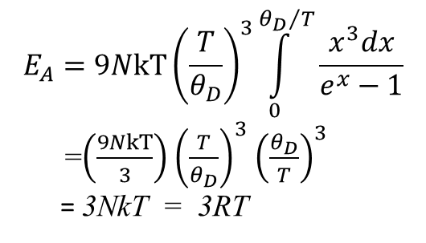
High and Low temperature Limits
The integral in the previous slide can be assessed in the high and low limits as follows.
High temperature limit : T >> θ_{D},
For very high temperatures, x is small and we can make the approximation : e^{x} ≈ 1 + x.
The integral becomes
So that the specific heat at high temperature limit : $cv=\frac{∂E}{∂T}=3R$
$$E_{A}=9NkT{\left(\frac{T}{θ_{D}}\right)}^{3}\int_{0}^{{θ_{D}}/T}{\frac{x^{3}dx}{e^{x}−1}}$$
=$\left(\frac{9NkT}{3}\right)$ ${\left(\frac{T}{θ_{D}}\right)}^{3}$ ${\left(\frac{θ_{D}}{T}\right)}^{3}$
= 3NkT = 3RT
Notes:
R = 1.985 8775 (34)cal K⁻¹ mol⁻¹
R = 8.3144621(75)^{[2]}J K⁻¹ mol⁻¹

Slide 23
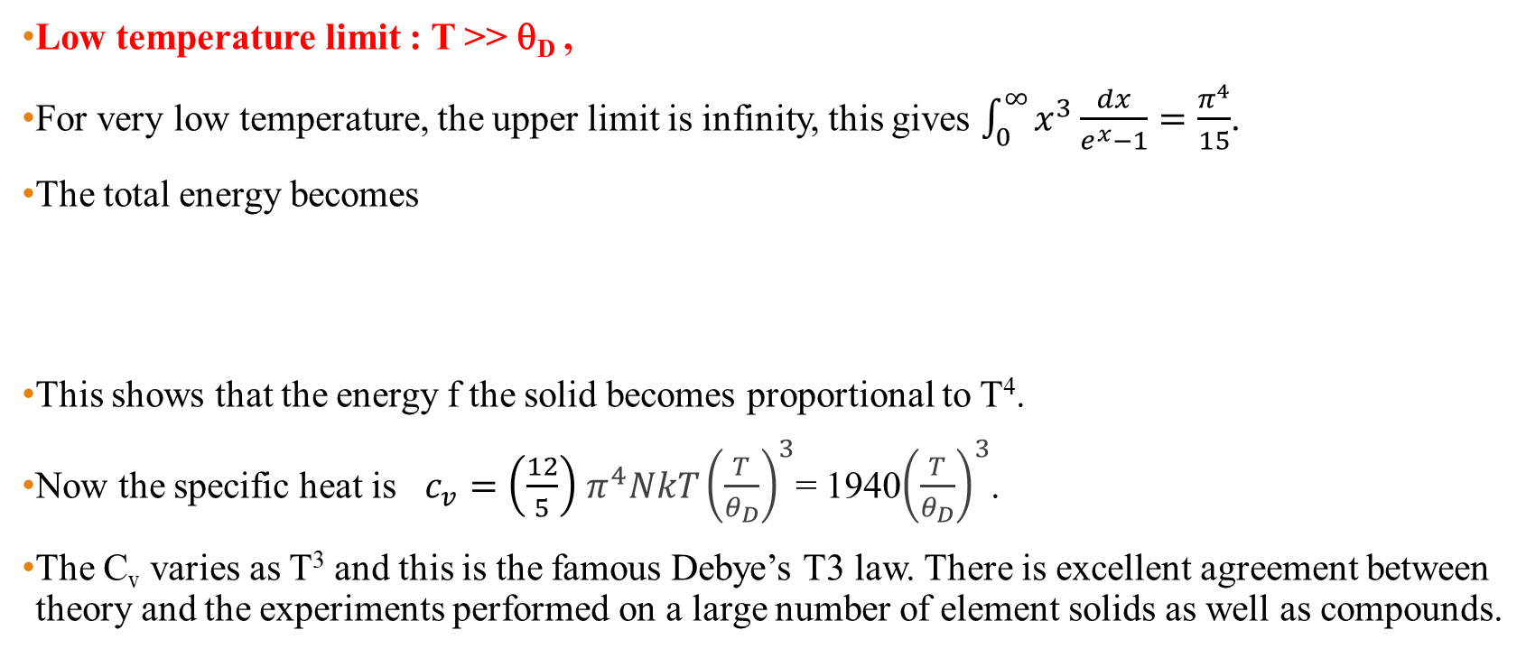
High and Low temperature Limits (cont.)
Low temperature limit : T >> θ_{D} ,
For very low temperature, the upper limit is infinity, this gives $\int_{0}^{∞}{x^{3}\frac{dx}{e^{x}−1}}=\frac{π^{4}}{15}$.
The total energy becomes
This shows that the energy f the solid becomes proportional to T⁴.
Now the specific heat is $c_{v}=\left(\frac{12}{5}\right)$ $π^{4}NkT{\left(\frac{T}{θ_{D}}\right)}^{3}$= 1940${\left(\frac{T}{θ_{D}}\right)}^{3}$.
The C_{v} varies as T³ and this is the famous Debye’s T3 law. There is excellent agreement between theory and the experiments performed on a large number of element solids as well as compounds.
$E_{A}=9NkT{\left(\frac{T}{θ_{D}}\right)}^{3}\int_{0}^{{θ_{D}}/T}{\frac{x^{3}dx}{e^{x}−1}}$ = $9NkT{\left(\frac{T}{θ_{D}}\right)}^{3}$ $\frac{π^{4}}{15}=\frac{3}{5}π^{4}NkT{\left(\frac{T}{θ_{D}}\right)}^{3}$

Slide 24
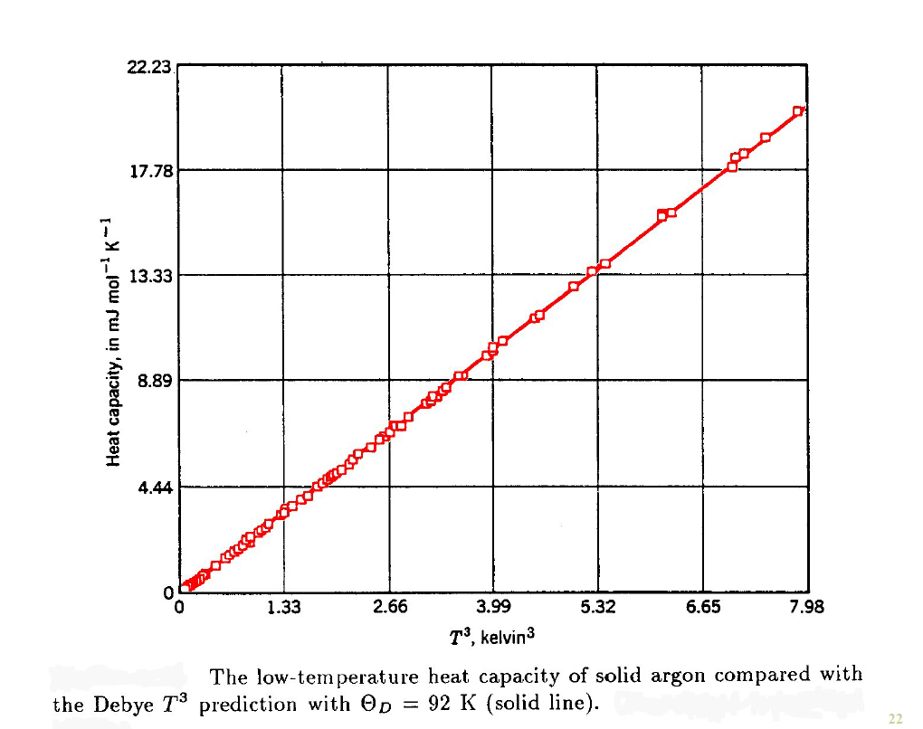
https://www.ucl.ac.uk/~ucapahh/teaching/3C25/Lecture11s.pdf

Slide 25
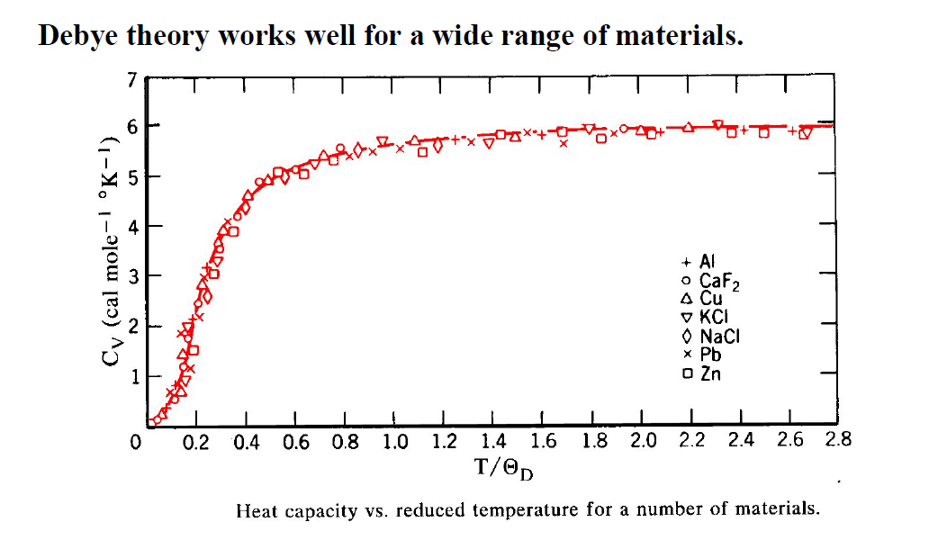
https://www.ucl.ac.uk/~ucapahh/teaching/3C25/Lecture11s.pdf

Slide 26
Homework #10
Problem 9.11, 9.12

